Slide 1
Java Collections - Introduction

Slide 2
Java Collections - Introduction
A Collection represents group of Objects.
We can use collections to store datasets in the form of objects.
Collections stores objects of similar types.
Java collections refer to a collection of individual objects that are represented as a single unit.
We can perform all operations such as searching, sorting, insertion, manipulation, deletion, etc., on Java collections just like you do it on data.
The Collection in Java is a framework that provides an architecture to store and manipulate the group of objects.
Java Collections can achieve all the operations that you perform on a data such as searching, sorting, insertion, manipulation, and deletion.
Java Collection means a single unit of objects.
Thus Collection in Java represents Data structures for storing, manipulating and retrieving data.

Slide 3
What is a Framework?
A framework is a set of classes and interfaces which provide a ready-made architecture. In order to implement a new feature or a class, there is no need to define a framework.
However, an optimal object-oriented design always includes a framework with a collection of classes such that all the classes perform the same kind of task.

Slide 4
What is Collection framework
The Collection framework represents a unified architecture for storing and manipulating a group of objects.
It has:
Interfaces and
its implementations, i.e., classes
Algorithm
These are Generic classes and interfaces and we could use data types at the time of using them in program.

Slide 5
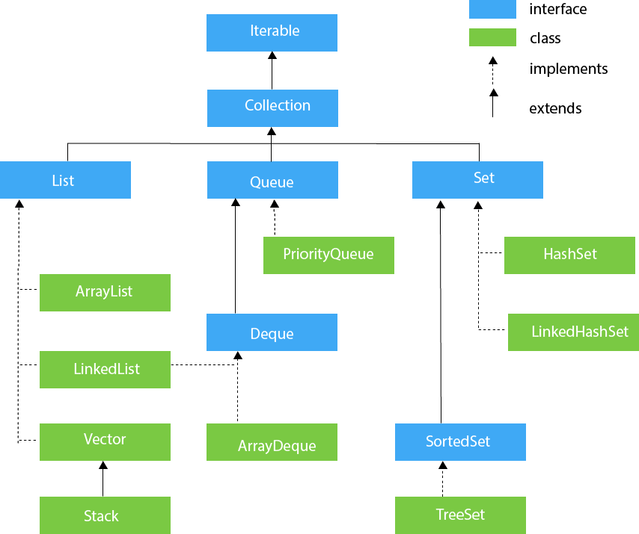
Hierarchy of Collection Framework
The java.util package contains all the classes and interfaces for the Collection framework.

Slide 6
Is Map a collection framework?
Although Maps are a part of Collection Framework, they can not actually be called as collections because of some properties that they posses. However we can obtain a collection-view of maps. It provides various classes: HashMap, TreeMap, LinkedHashMap for map implementation.

